Slide 1

Managing Transactions and Concurrency Control
23 April 2026
Lynette Barnard

Slide 2

Transactions
Logical unit of work
Completed in its entirety; or aborted
Reflects real-world transactions
Triggered by an event
E.g. when you withdraw money at ATM
Typically formed by multiple requests
E.g. authenticate client; check funds; if ok, not updated balance; dispense funds; finalise balance
Takes database from one consistent state to another
Often SQL used to represent transactions
www.freepik.com

Slide 3
Atomicity
ALL operations of transaction must be completed; if not, transaction is aborted
Consistency
Transaction takes database from one consistent state to another
Isolation
Data cannot be used by 2nd transaction until 1st transaction done with it
Durability
Once transaction commits, it cannot be undone or lost
Serialisability
In multi-user and distributed databases: concurrent execution of several transactions yield consistent results
Transaction properties: ACIDs
Chapter 12 - Managing Transactions and Concurrency Control

Slide 4
Serialisability
2 transactions – T1 and T2
Share data items
T1 and T2 each has “own” memory space for data values
T1 and T2 not “aware” of contents of memory space of the other T
Final data item values should be the same at end of execution for each case
Case 1 - T1 executes entirely; then T2 executes entirely
Case 2 - T2 executes entirely; then T1 executes entirely
Case 3 - T1 and T2 interleave, as submitted to scheduler

Slide 5
Serialisability
T1 | T2
Read A
 | Read B
 | Read A
 | A = B - A
 | Write A
Read B
B = B + A
Write B
How to test for serialisability
2
1
1
Test with starting values, e.g.
A = 5
B = 6
Check (for our purposeWRITE updates database)
Case 1: T1 completes; then T2
Case 2: T2 completes; then T1
Case 3: T1 and T2 interleave
Compare values of A and B after each case
2

Slide 6
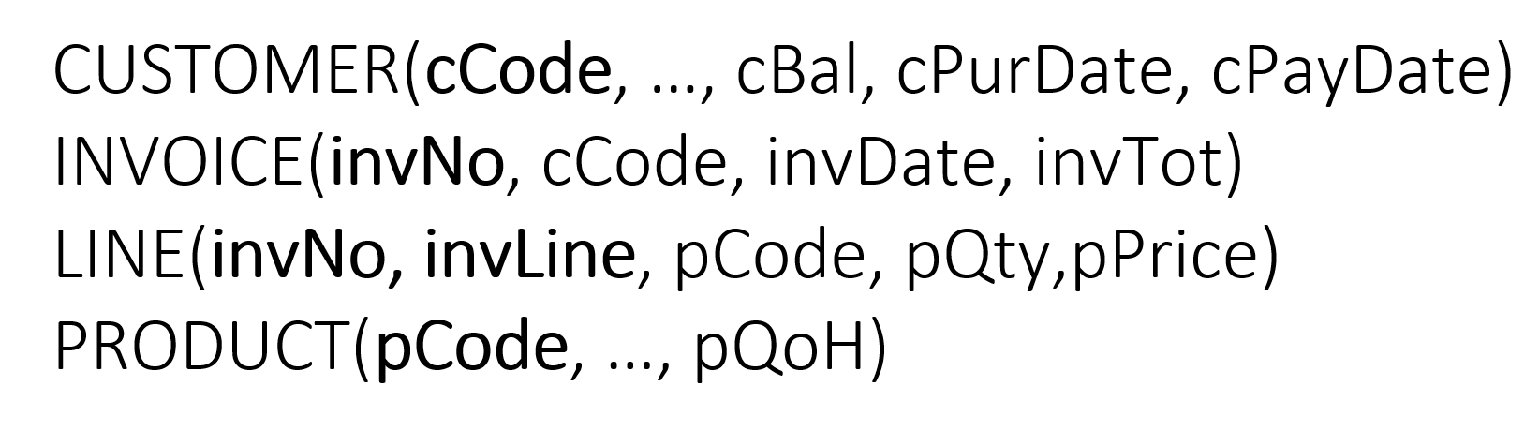
Transaction log
BEGIN TRANSACTION
INSERT INTO INVOICE
VALUES (55, ‘8807’, ’23-Apr-2026’, 115);
INSERT INTO LINE
VALUES (55, 1, ‘XXAX’, 1, 100.00);
UPDATE PRODUCT
SET pQoH = pQoH – 1
WHERE pCode = ‘XXAX’;
UPDATE CUSTOMER
SET cPurDate = ’23-Apr-2026’, cBal = cBal +115
WHERE cCode = ‘8807’;
COMMIT;
pQoH = 40
cBal = 300
cPurDate = 14-Mar-2025

Slide 7
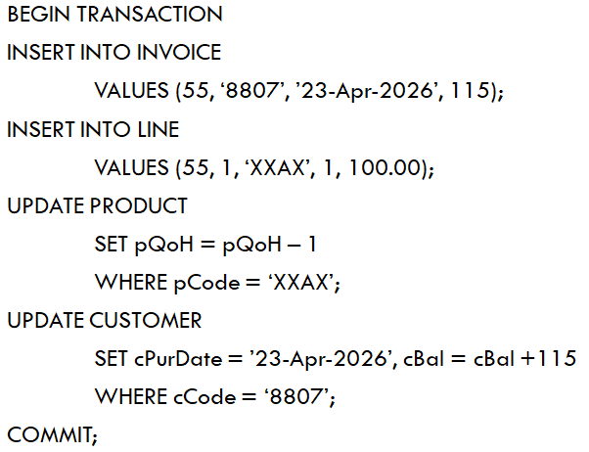
Transaction log
pQoH = 40
cBal = 300
cPurDate = 14-Mar-2025
TRL ID | TRX NUM | PREV PTR | NXT PTR | OPERATION | TABLE | ROW ID | ATTRIBUTE | BEFORE VALUE | AFTER VALUE
987 | 101 | Null | 988 | START | *Start TRX
988 | 101 | 987 | 989 | INSERT | INVOICE | 55 |  |  | 55,8807,23-Apr-2026,115
989 | 101 | 988 | 990 | INSERT | LINE | 55,1 |  |  | 55,1,XXAX,1,100.00
990 | 101 | 989 | 991 | UPDATE | PRODUCT | XXAX | pQoH | 40 | 39
991 | 101 | 990 | 992 | UPDATE | CUSTOMER | 8807 | cBal | 300 | 415
992 | 101 | 991 | 993 | UPDATE | CUSTOMER | 8807 | cPurDate | 14-Mar-2025 | 23-Apr-2026
993 | 101 | 992 | Null | Commit | *End TRX

Slide 8
Concurrency Control
T1​ | T2​ | Result​
Read​ | Read​ | No conflict​
Read​ | Write​ | Conflict​
Write​ | Read​ | Conflict​
Write​ | Write​ | Conflict​
Some examples covered in videos
Lost updates
Uncommitted data
Inconsistent retrievals
Scheduler facilitates data item isolation
Conflict if two operations access same data item and at least one operation is WRITE

Slide 9
Concurrency Control
Time | T1 | T2
1 |  | Read B
2 |  | Read C
3 |  | B = B+C
4 |  | Write B
5 | Read A
6 | Read B
7 | B =B*1.5
8 | A = A–B
9 | Write A
10 |  | Read A
Example
Consider the following two transactions, T1 and T2.
The transactions are interleaved in their execution, from time 1 through to time 10 (the time is indicated in the left most column in the table).
At time 10, T2 fails and is aborted.
Identify the type of problem that occurred and explain why & where this problem occurred.
Undone; no commit
Read a value that no longer exists (data not committed)

Slide 10
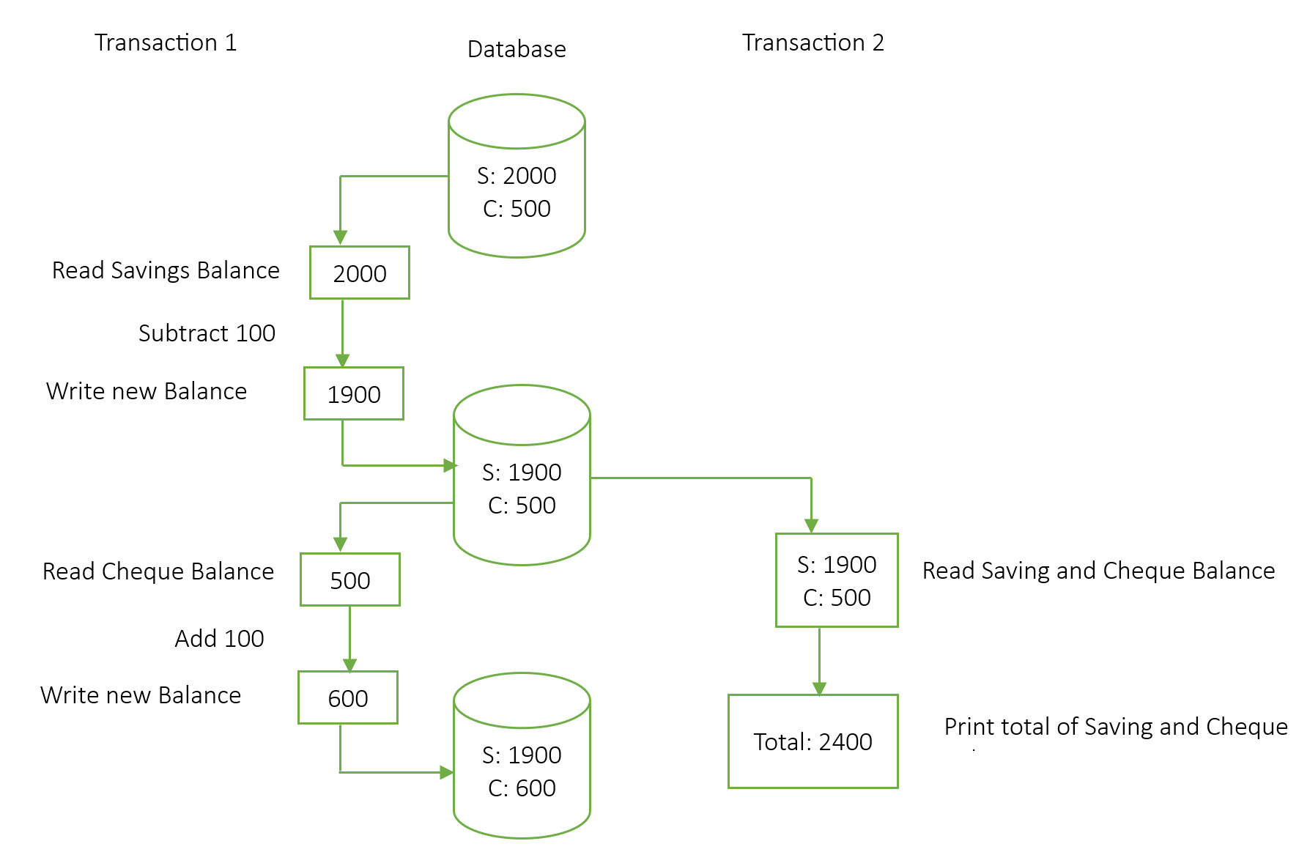
Inconsistent retrieval example Move 100 from Savings to Cheque

Slide 11
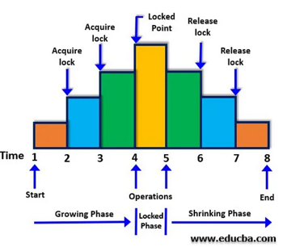
Concurrency Control
Used with Locking
Locks used to guarantee exclusive data item use
Various lock granularity, e.g.
Database, table, row, attribute, page
Lock types
Binary (locked / not locked)
Shared and exclusive locks
Shared allows read access (>1 transaction may share)
Exclusive allows write access (1 transaction owns lock)
Issues with locks
Serialisability (handled through 2PL)
Deadlocks / deadly embrace (detection and prevention)

Slide 12
Pessimistic locking, no 2PL
T | Action
1 | Lock INVOICE
2 | Insert row 55 into INVOICE
3 | Unlock INVOICE
4 | Lock LINE
5 | Insert row 55, 1 into LINE
6 | Unlock LINE
7 | Lock PRODUCT
8 | Update PRODUCT XXAX, pQoH from 40 to 39
9 | Unlock PRODUCT
10 | Lock CUSTOMER
11 | Update CUSTOMER 8807, cBal from 300 to 415
12 | Update CUSTOMER 8807, cPurDate from 14-Mar-2025 to 23-Apr-2026
13 | Unlock CUSTOMER
BEGIN TRANSACTION
INSERT INTO INVOICE
VALUES (55, ‘8807’, ’23-Apr-2026’, 115);
INSERT INTO LINE
VALUES (55, 1, ‘XXAX’, 1, 100.00);
UPDATE PRODUCT
SET pQoH = pQoH – 1
WHERE pCode = ‘XXAX’;
UPDATE CUSTOMER
SET cPurDate = ’23-Apr-2026’, cBal = cBal +115
WHERE cCode = ‘8807’;
COMMIT;

Slide 13
Pessimistic locking, with 2PL
T | Action
1 | Lock INVOICE
2 | Lock LINE
3 | Lock PRODUCT
4 | Lock CUSTOMER
5 | Insert row 55 into INVOICE
6 | Insert tow 55, 1 into LINE
7 | Update PRODUCT XXAX, pQoH from 40 to 39
8 | Update CUSTOMER 8807, cBal from 300 to 415
9 | Update CUSTOMER 8807, cPurDate from 14-Mar-2025 to 23-Apr-2026
10 | Unlock CUSTOMER
11 | Unlock PRODUCT
12 | Unlock LINE
13 | Unlock INVOICE
BEGIN TRANSACTION
INSERT INTO INVOICE
VALUES (55, ‘8807’, ’23-Apr-2026’, 115);
INSERT INTO LINE
VALUES (55, 1, ‘XXAX’, 1, 100.00);
UPDATE PRODUCT
SET pQoH = pQoH – 1
WHERE pCode = ‘XXAX’;
UPDATE CUSTOMER
SET cPurDate = ’23-Apr-2026’, cBal = cBal +115
WHERE cCode = ‘8807’;
COMMIT;

Slide 14
Concurrency control with time stamping
One example handled in video – two schemes
Wait / Die
Wound / Wait
Wait / Die and Wound / Wait concurrency control schemes
Transaction requesting lock | Transaction owning lock | Wait / Die | Wound / Wait
T1 (older) | T2 (younger) | T1 waits for T2 to complete and for T2 to release all locks | T1 rolls back T2 T2 rescheduled, using same (original) time stamp
T2 (younger) | T1 (older) | T2 rolls back (dies) T2 rescheduled, using same time stamp | T2 waits for T1 to complete and T1 to release all locks

Slide 15
Concurrency control
With time stamping example
Consider sequence of operations (S1), listed in the order it is submitted to DBMS
S1:
T2: R(A); T3: W(B); T4: W(C); T3: W(C); T1 commits; T3: W(A); T4: R(B); T2 commits; T3 commits
The timestamps of the transactions are as follows:
T1=101, T2=102, T3=103, T4 = 104
T1 holds an exclusive lock on data item A at the start of the sequence.
Make use of time stamping concurrency control mechanism, implemented using Wound / Wait scheme, to show how sequence is handled.

Slide 16
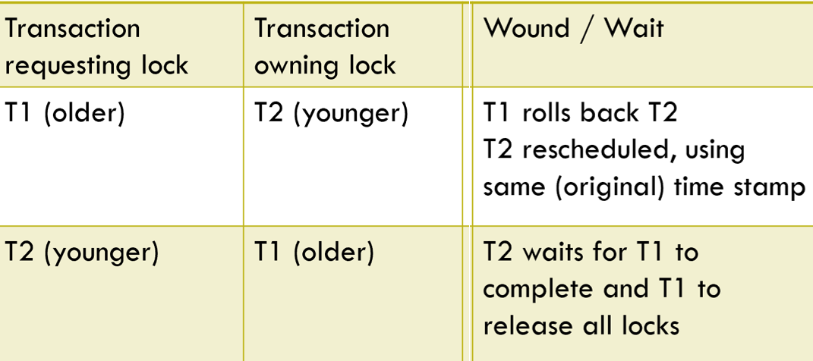
T2: R(A); T3: W(B); T4: W(C); T3: W(C); T1 commits; T3: W(A); T4: R(B); T2 commits; T3 commits Timestamps of transactions: T1=101, T2=102, T3=103, T4 = 104 T1 holds an exclusive lock on data item A at the start of the sequence.
Wound / Wait
T2: R(A)
T3: W(B)
T4: W(C)
T3: W(C)
T1 commits
T3: W(A)
T4: R(B)
T2 commits
T3 commits
T2 requests read lock on A; T1 holds a write lock; T2 needs to wait for T1 to complete
T3 requests write lock on B and gets it
T4 requests write lock on C and gets it
T3 requests write lock on C; T4 holds exclusive lock on C; T3 older than T4, so T3 rolls back (wounds) T4 and gets lock; T4 rescheduled (kicked out of sequence) to start later, using original timestamp
releases all locks (exclusive lock on A); T2 obtains shareable lock on A
T3 requests write lock on A; T3 younger than T2, T2 currently holding read lock on A; T3 needs to wait on T2
T4: R(B) nothing happens; T4 was wounded / rolled back by T3 earlier
releases all its locks (read lock on A); T3 to obtain write lock on A
releases all its locks (write locks on B, C and A); T4 restarted with original timestamp

Slide 17
Database recovery management
Aim to restore database to previous consistent state
Recovery based on atomicity
Transaction property ensuring all operations of transactions complete
Concepts impacting recovery process
Write-ahead-log protocol
Redundant transaction logs
Buffers (temp storage area in primary memory)
Checkpoints (operation writing buffer updates to disk)

Slide 18
Transaction recovery procedures
Techniques used covered in video
Deferred-write (deferred update)
Write-through (immediate update)
Identify last checkpoint
If transaction committed before last checkpoint, do nothing
If transaction committed after last checkpoint
Use transaction log to REDO transaction using “after” values in log in ascending order (old to new)
If transaction had ROLLBACK or was left active after last checkpoint, do nothing
Identify last checkpoint
If transaction committed before last checkpoint, do nothing
If transaction committed after last checkpoint
Use transaction log to REDO transaction using “after” values in log in ascending order (old to new)
If transaction was active after last checkpoint
Use transaction log to UNDO operations, using “before” values in log (reversed, new to old)
ROLLBACK happens immediately (UNDOne at rollback)

Slide 19
Transaction recovery example
2026-04-21 | 07:30:00 | T10 Commit
2026-04-21 | 07:30:05 | T2 Read C
2026-04-21 | 07:30:09 | T1 Read A
2026-04-21 | 07:30:15 | T4 Read C
2026-04-21 | 07:30:18 | T3 Read B
2026-04-21 | 07:30:20 | T2 Commit
2026-04-21 | 07:30:24 | T1 T3 T4 | //checkpoint
2026-04-21 | 07:30:28 | T1 Write C
2026-04-21 | 07:30:32 | T4 Write B
2026-04-21 | 07:30:33 | T3 Write A
2026-04-21 | 07:30:34 | T5 Write C
2026-04-21 | 07:30:39 | T11 Read A
2026-04-21 | 07:30:40 | T4 T5 T11 | //checkpoint
2026-04-21 | 07:30:42 | T6 Read C
2026-04-21 | 07:30:46 | T6 Read A
2026-04-21 | 07:30:49 | T6 Abort
2026-04-21 | 07:30:52 | T7 Write B
2026-04-21 | 07:30:54 | T7 Commit
2026-04-21 | 07:30:58 | T11 Commit
2026-04-21 | 07:31:01 | T8 Read A
2026-04-21 | 07:31:04 | T8 Write C
2026-04-21 | 07:31:15 | T9 Read C
2026-04-21 | 07:31:16 | T9 Read B
At time 07:31:17 the system fails.
Use the log to explain how the database will be brought back to a consistent state (which transactions to be redone, if any, and which undone, if any, in an immediate update environment).
Checkpoint
Commit after checkpoint (redo)
Active (undo)
Abort (rollback) – took place at time of abort (rollback)

Slide 20

Semester test 2 – second notice
Schedule:
Tuesday, 12 May
May bring in ONE page (double sided) hand written (no photocopies) notes
2-hour test, 60 marks
Time to be confirmed – depends on lab availability (venues shared with another module this time)

